Slide 1
Ambic Stem Challenge
The next generation of creatives.

Slide 2
Learning Objective
To evaluate my product against the design criteria.
Success Criteria
I can answer questions about my product based on the agreed design criteria.
I can identify how my design achieved the design criteria
I can suggest possible improvements or changes I would make to my design.

Slide 3
What can you remember about our previous lesson?
Are you all happy with your prototype?

Slide 4
Today we are going to evaluate our prototypes and designs.
This is a key part of our project managers job as this is the step before it goes into manufacturing.

Slide 5
Why were you designing the furniture?
What was the problem or issue you identified in your school?

Slide 6
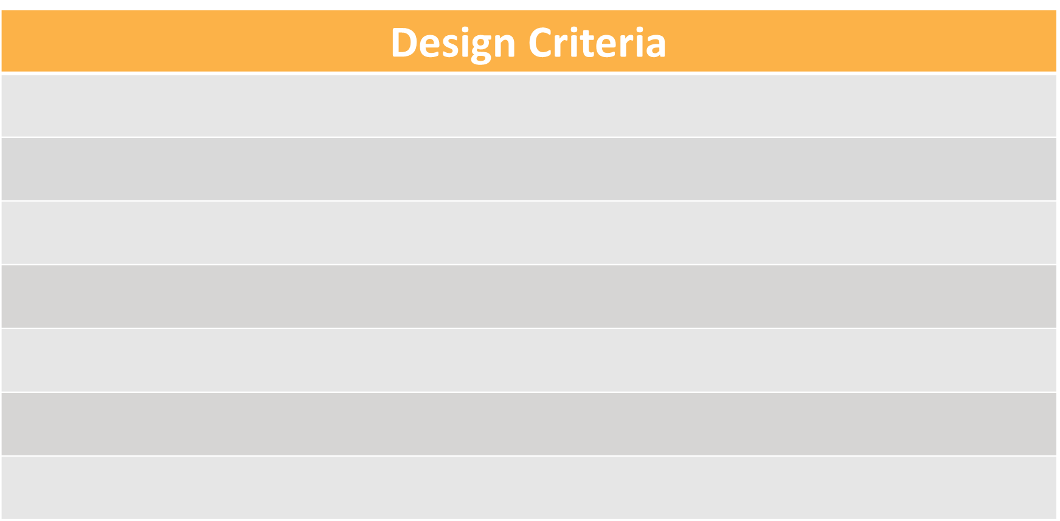
The design criteria:

Slide 7
The design criteria:
How could you achieve each aim?

Slide 8
Peer Evaluation.
You are now going to have some time to evaluate each others designs and prototypes.

Slide 9
Peer Evaluation.
Great design, I like how you… | You might want to think about improving

Slide 10
Your feedback.

Slide 11
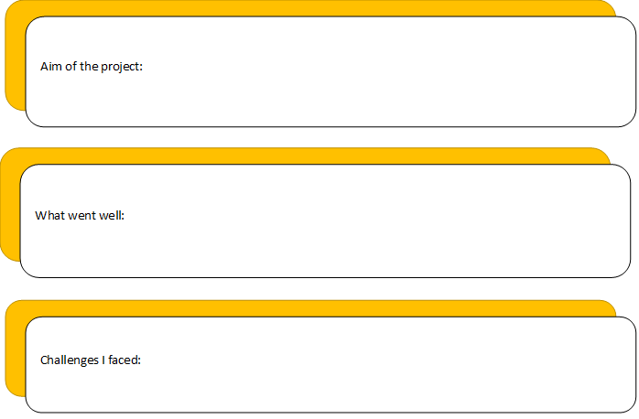
Self evaluation.

Slide 12
Now, you are going to be evaluating your own design and prototype.

Slide 13
Finishing up.
What have you learnt?
Why is the process you have completed important?
What have you enjoyed?
Is there anything that you would like to change with your design?
Why are prototypes important?

Slide 14
Finishing up.
You have all just completed a real life process.
Is there anything else you would like to ask Ambic?

Slide 15
We hope you have enjoyed the Ambic Stem Challenge.
Good luck!

