Slide 1
Ambic Stem Challenge
The next generation of creatives.

Slide 3
Learning Objective
To explore and evaluate a range of existing products.
Success Criteria
I can use the internet to research different furniture used in school.
I can identify the different types of furniture in school.
I can recognise positives and negatives in different furniture.

Slide 4
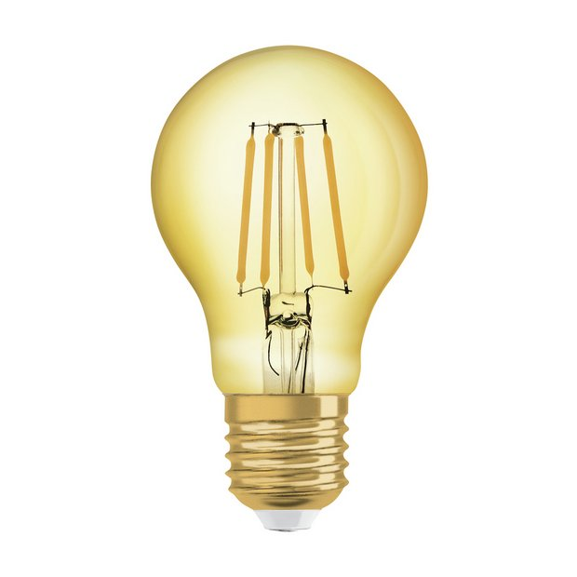
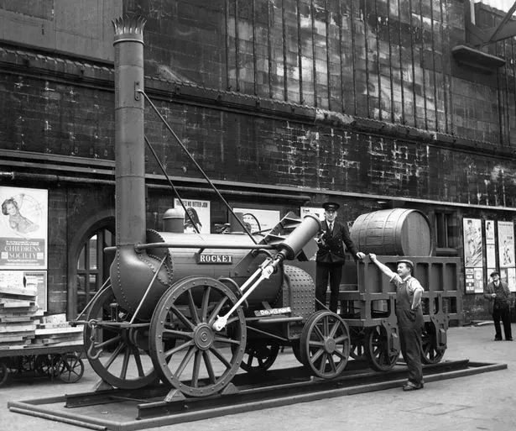
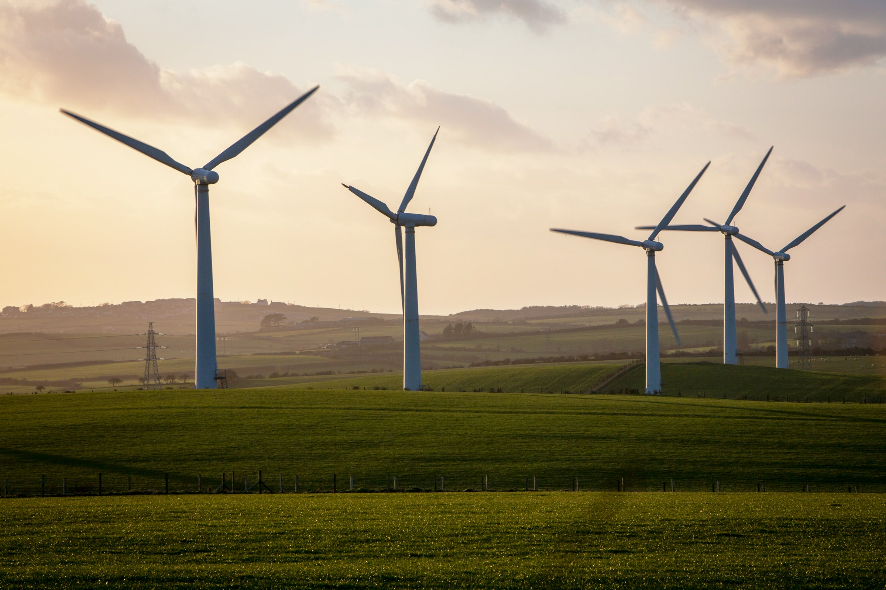
As the world evolves, people encounter problems that there are currently not answers or solutions for.
Yet, inventors and designers think of ways to solve these problems.
Have a look at these revolutionary inventions and think about what problem or dilemma they solved.

Slide 5
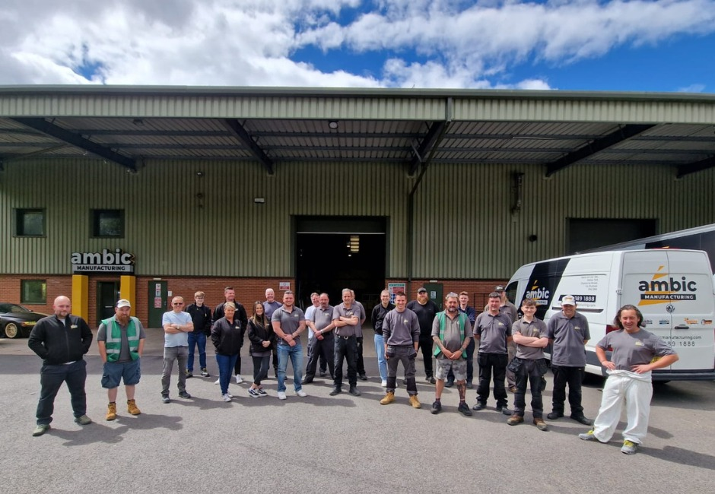
We are a bespoke furniture manufacturing factory based in Chester-le Street.
Who is Ambic Manufacturing?
We employ over 30 members of staff who come from a range of backgrounds and education.
We make furniture for schools, universities, laboratories restaurants and much more.
We have 4 industry experts that meet with clients to discuss the needs or problems they are having.
Headteachers normally come to us to manufacture something specifically for their school.
There is over 10 different departments that work together closely to manufacture a product.
We work with wood, metal, man-made material such as laminate and solid surface.
We love when schools ask us for something unique and different!
We are based here in the North East!

Slide 6
S
T
E
M
Science
Technology
Engineering
Maths
We use these 4 ideas every day at Ambic.

Slide 7
Let’s learn some vocabulary.
Word | Heard before | Prediction | Actual Meaning | Use in a sentence
Innovative
Practical
Ergonomic
Engineer
Ingenuity

Slide 8
When schools are looking for new furniture for their classrooms or shared spaces, the normally look online or in a catalogues.
Has your teacher done this?
It is easy to see what you can purchase by doing a quick search on the internet.
Have a go at searching these phrases on images on a search engine.
Children’s school furniture
Furniture for schools
Classroom storage
Bespoke school furniture.
It is also product designers and our project managers do when asked for new and innovative furniture.

Slide 9
Your task today:
You are all going to do some market research using the internet.
You are going to be investigating what different types of furniture schools can already buy.

Slide 10
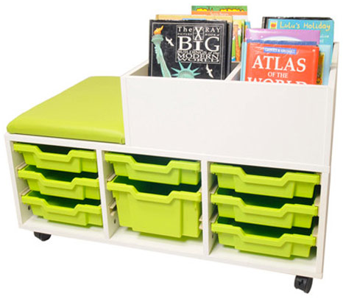
What do you think it is made from?
Is it practical?
How could you describe the shape?
Would this piece of furniture fit in our school?
What is this piece of furniture used for?
How could you describe surface?
Do you like it?
Who might use it? How do you know?
How could you describe colour?

Slide 11
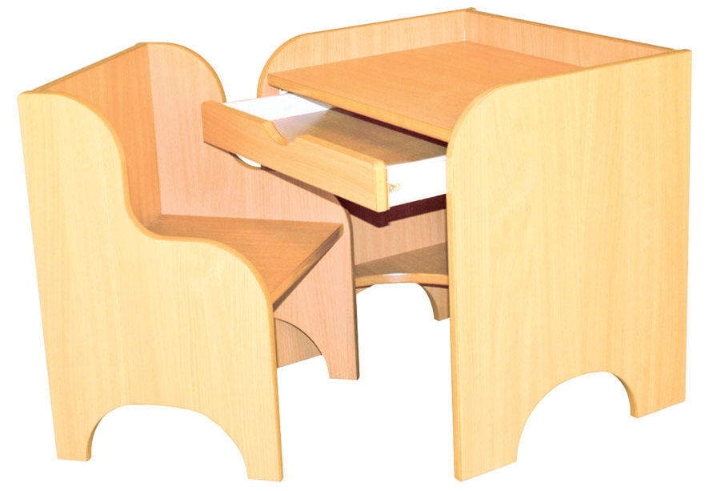
What do you think it is made from?
Is it practical?
How could you describe the shape?
Would this piece of furniture fit in our school?
What is this piece of furniture used for?
How could you describe surface?
Do you like it?
Who might use it? How do you know?
How could you describe colour?

Slide 12
What do you think it is made from?
Is it practical?
How could you describe the shape?
Would this piece of furniture fit in our school?
What is this piece of furniture used for?
How could you describe surface?
Do you like it?
Who might use it? How do you know?
How could you describe colour?

Slide 13
What do you think it is made from?
Is it practical?
How could you describe the shape?
Would this piece of furniture fit in our school?
What is this piece of furniture used for?
How could you describe surface?
Do you like it?
Who might use it? How do you know?
How could you describe colour?

Slide 14
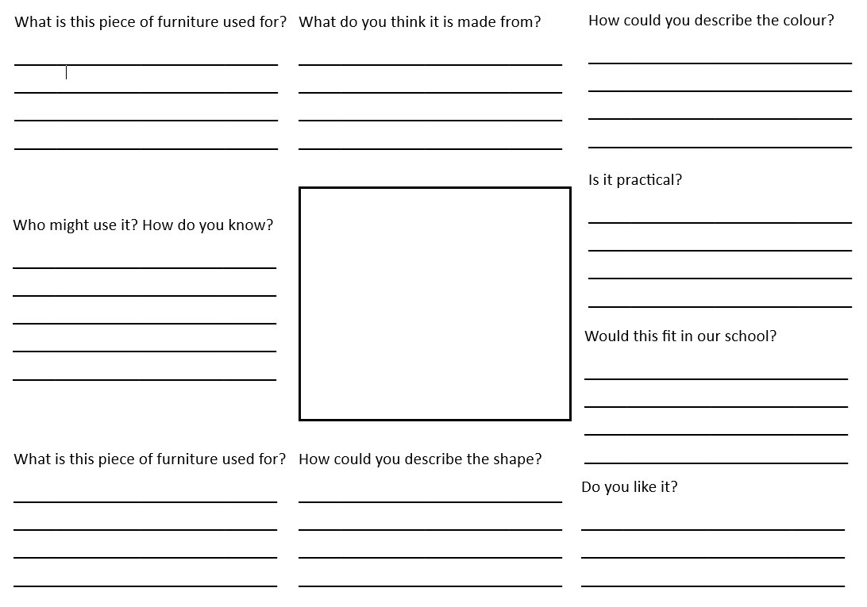
Your turn now:
Use the internet to find examples of school furniture.
Use the resource sheet to complete an analysis.

Slide 15
What makes a ‘good’ piece of furniture?

Slide 16
Ambic Stem Challenge
The next generation of creatives.
If you didn’t see a piece of furniture you liked today or one that would fit in our school, we might have to design our own…

